Slide 1

DealTracker
— Interim Project Presentation 1
https://github.com/buChloeCLY/CS501-Project-DealTracker
Team: Leyan Chen, Yijia Chen, Juling Fan

Slide 2
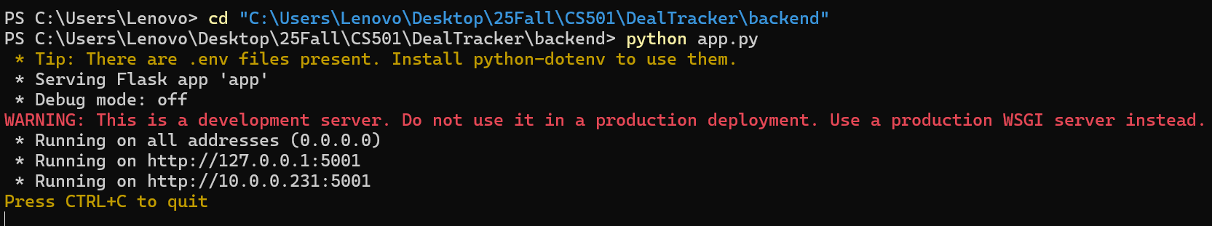
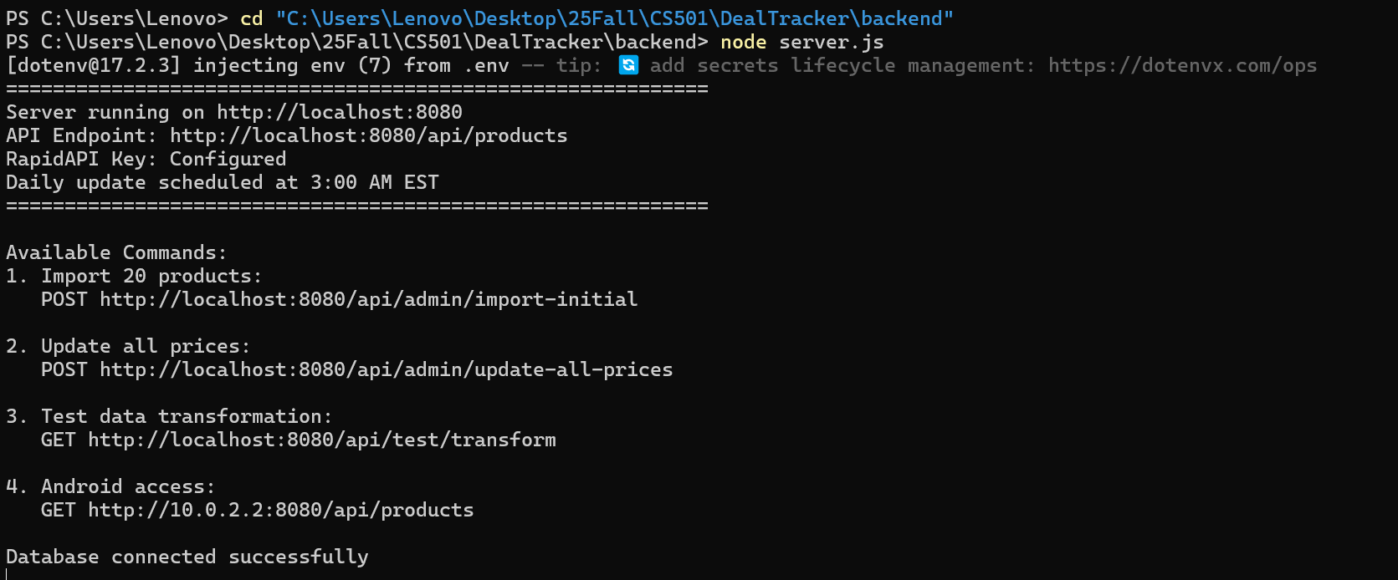
Backend Setup

Slide 3
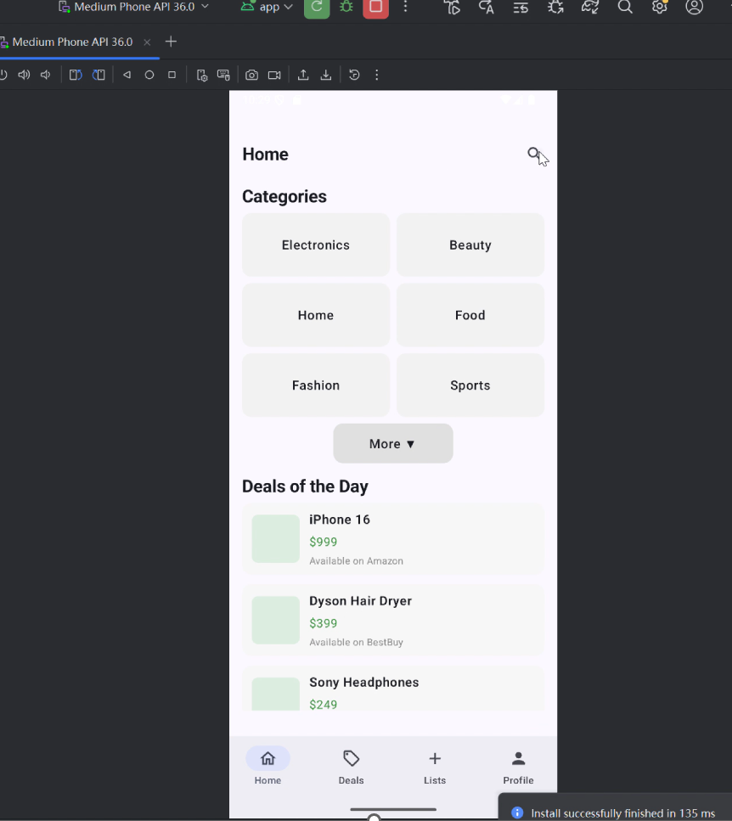
Live demo

Slide 4
Recap of Proposal
“Deals of the Day” Section
Products sorted by 24-hour price drops. Personalized recommendations based on user wishlist
API Strategy Optimization
Multiple official e-commerce APIs. Unified RapidAPI integration
Team workflow
UI → Database → API
Maintained feature branches for each major screen and backend modules.
Tracked issues for bug reports, feature requests, and review notes.
Used Pull Requests for code review before merging.

Slide 5
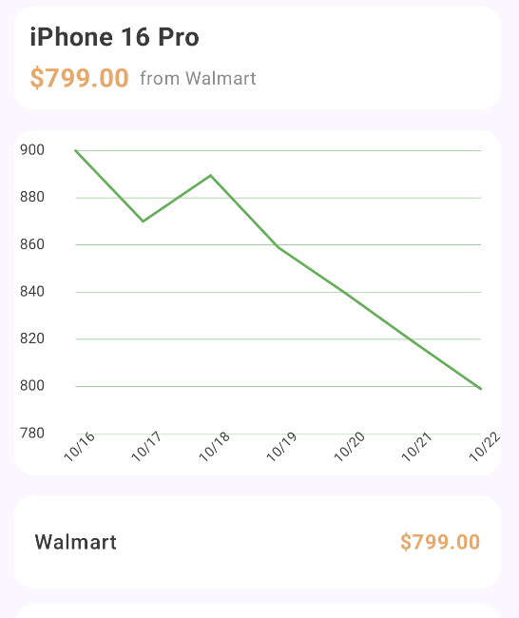
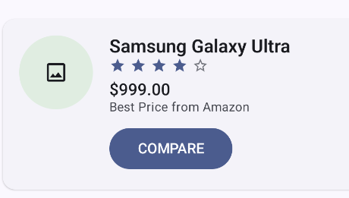
Current architecture
Backend
Frontend
Detail Page
Database
(MySQL)
History prices
RetroClient1
Today’s prices
RetroClient2
Deals Page & Home Page
Everyday prices
Amazon
Walmart
…

Slide 6
Backend
Application
/backend
/app
UI
Domain
HomeScreen
Models
(Product, Category, …)
Flask
Repository
(Product, Price, …)
DealsScreen
Node.js
DetailScreen
Data Layer
Local
Remote
ProfileScreen

Slide 7
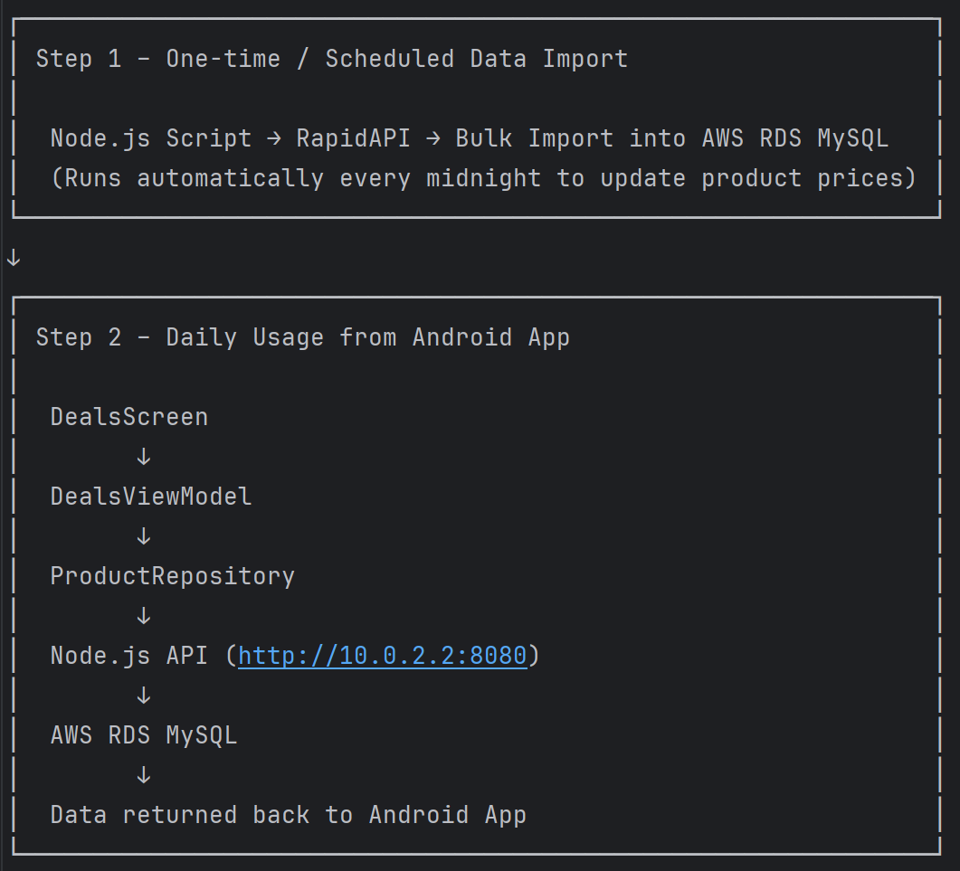
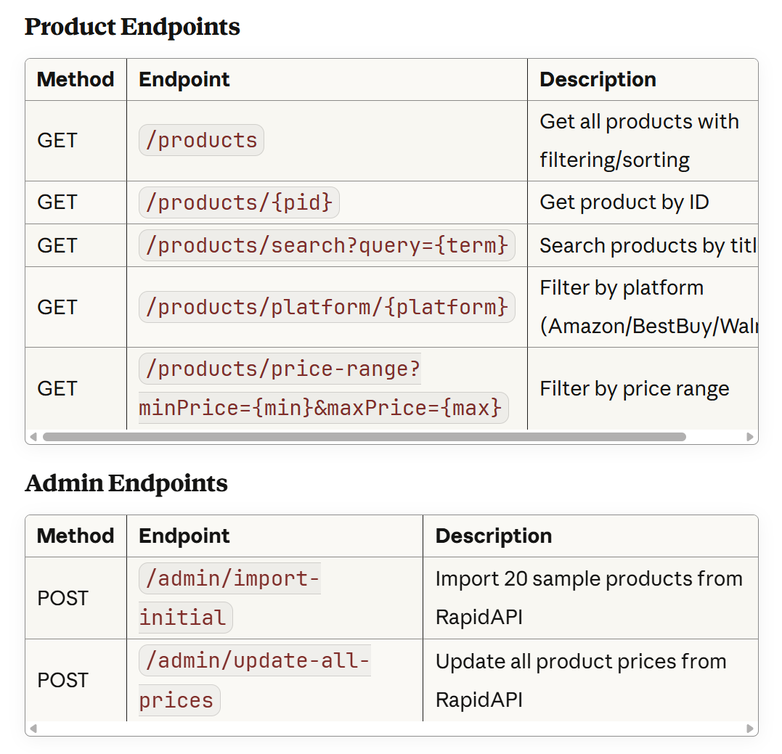
API Design
Data Source: RapidAPI
API Used: Real-Time Amazon Data API (currently)

Slide 8
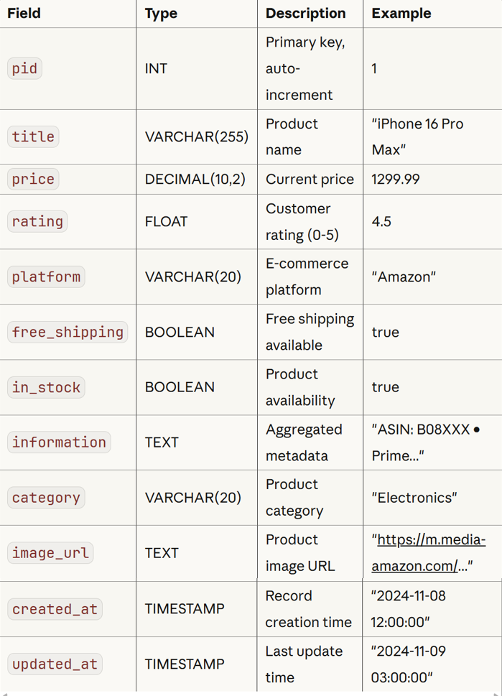
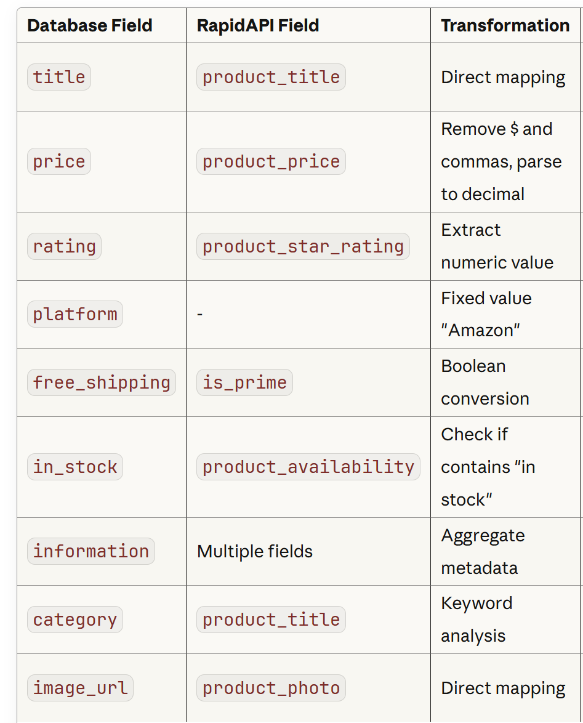
Database Design
Data Transformation: RapidAPI → Database
The Node.js backend transforms raw RapidAPI data before storing it in the database:
The application uses AWS RDS MySQL 8.0 as the database platform.
Products table

Slide 9
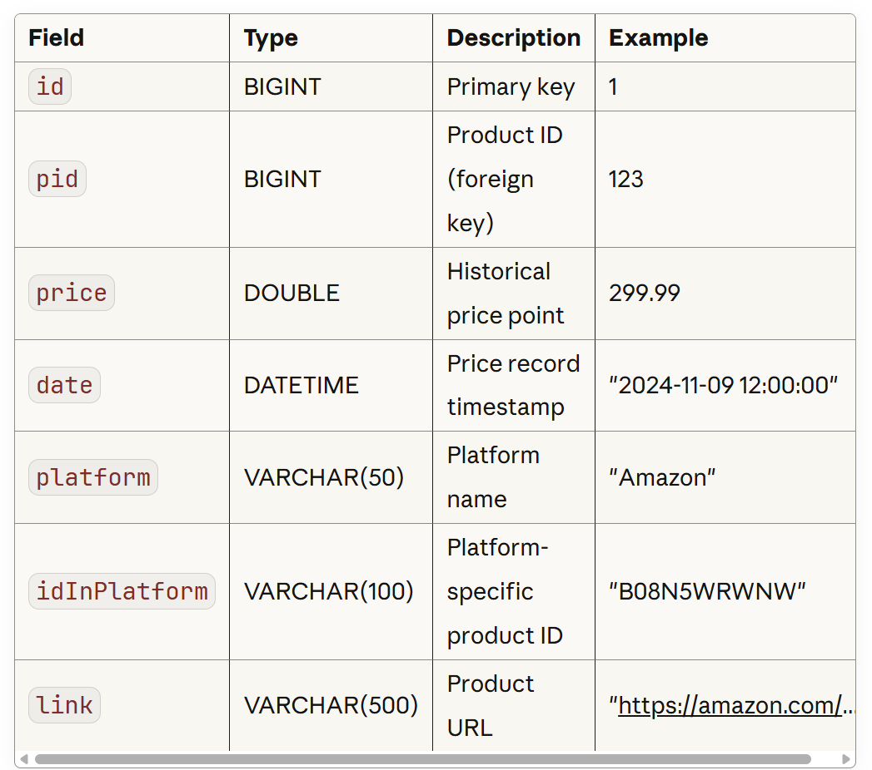
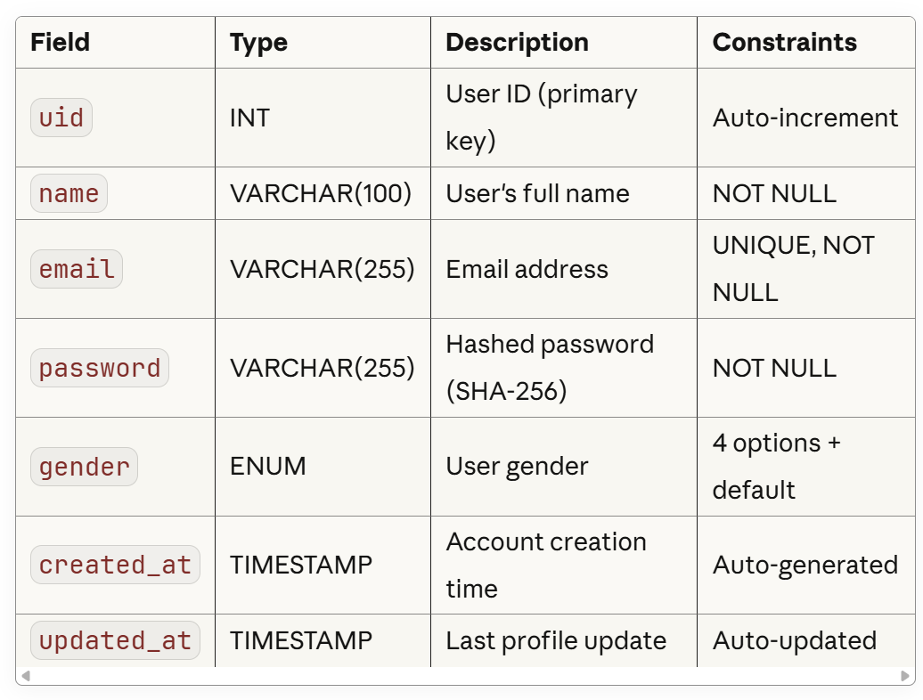
Table 2: Price
Purpose: Stores historical price data for trend analysis and charts.
Status: Currently used by Flask backend for price history visualization.
Table 3: User
Purpose: User account management and authentication.

Slide 10
Challenges faced + solutions tried + future work
Dual Backend System
  Problem: The application currently runs two separate backend services:
    Node.js (Port 8080): Product data and RapidAPI integration
    Flask (Port 5001): User authentication and price history charts
  Root Cause:
    Flask backend was developed first for database connection testing.
    Node.js backend added later for robust RapidAPI integration.
    Historical price visualization still depends on Flask.
  Future Plan: Deprecate Flask backend; Implement price history API in Node.js; Consolidate to single Retrofit client in Android.

Slide 11
Server Uptime Requirement
  Problem: Node.js server must run continuously for scheduled price updates to work.
  Future plan: Cloud Deployment
    Deploy to AWS EC2, Heroku, or Railway;
    Cloud platforms provide 99.9% uptime;
    Automatic restart on failure.

Slide 12
Thanks for Listening

